Slide 1
Platform commuincation – How not to confuse our customers?
Adrian Herzing | 17.09.2018

Slide 2
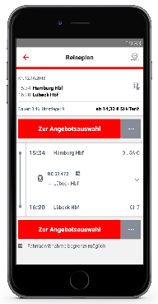
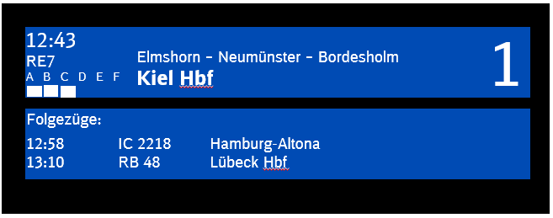
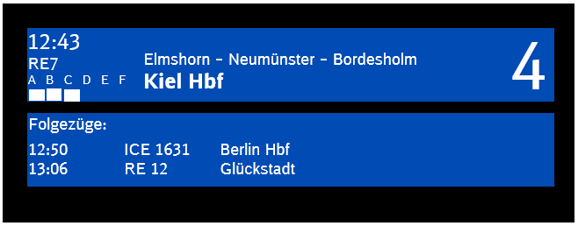
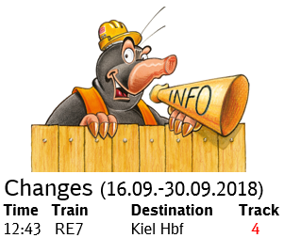
Platform changes that are planned in advance are not announced as changes in the app or on the display
Departure (10.06.-09.12.2018)
Time Train Destination Track
12:43 RE7 Kiel Hbf 1
12:50 ICE 1631 Berlin Hbf 4
12:58 IC 2218 Hamburg-Altona 1
13:06 RE12 Glückstadt 4
13:10 RB 48 Lübeck Hbf 1
A train is planned to arrive everyday on platform 1…
12:43 Hamburg Hbf 1
13:55 Kiel Hbf 2
Departure (10.06.-09.12.2018)
Time Train Destination Track
12:43 RE7 Kiel Hbf 1
12:50 ICE 1631 Berlin Hbf 4
12:58 IC 2218 Hamburg-Altona 1
13:06 RE12 Glückstadt 4
13:10 RB 48 Lübeck Hbf 1
… due to construction a conflict arises and the train is planned to arrive on platform 4 for two week.
12:43 Hamburg Hbf 4
13:55 Kiel Hbf 2

Slide 3
If there are two (internal) tracks on one platform, a platform change can only be announced to the whole platform OR to one of the sectors.
Platform 5
Platform 5 A-C
(internal: 205)
Platform 5 D-F
(internal: 305)
Dispatch
Mapping
205 305 206 306
internal | external
205 | 5
305 | 5
12:43 Hamburg Hbf 5
13:55 Kiel Hbf 2
internal | external
205 | 5 A-C
305 | 5 D-F
Platform change
206 → 306*
* Trains that are long enough to arrive on both tracks, get the new track according to the position of the front.

