Slide 1
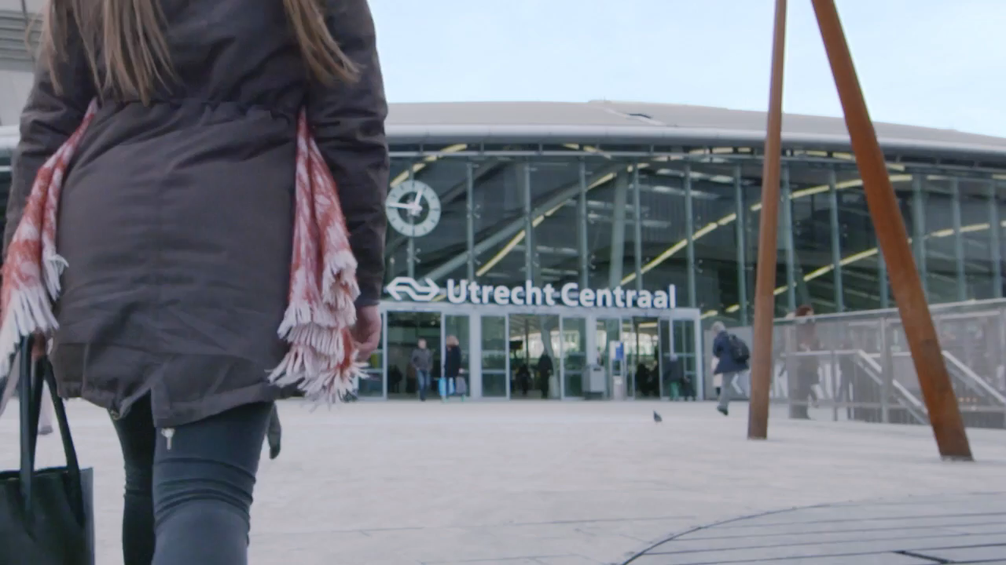
Important issues for passenger information at stations in the Netherlands
Barcamp Berlin - september, 2018

Slide 2
Introduction
Railway travel is booming in the Netherlands: we transport more and more passengers each year and trains are very full especially during peak hours.
Measures are needed to regulate the flow of passengers and try to spread our passengers not only within the train but also over trains. This will also help the punctuality of our trains, very much needed on the tracks where we run trains every 10 minutes in the same direction.
Our station displays are going to be part of a “proof of concept” to support that trains will depart on time. We will develop a new design for our station displays for this. I want to share the first designs that have been made.

Slide 3
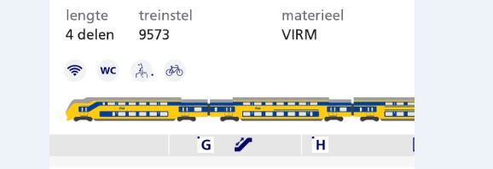
Introduction
We also want to inform passengers about the position of the train relating to the platform (DB already does this) so they have more chance to find a seat. We already show this in our app (see image below) but we also want to develop something similar for our station displays. For international trains we already show the train composition on separate displays on the platform (but only at a few stations).

Slide 4
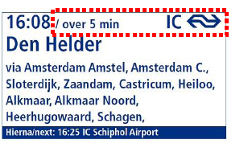
Supporting the trainmanager to depart on time
Five minutes before planned departure time we will show that the train will depart in 5 minutes (4, 3, 2, 1, <1).

Slide 5
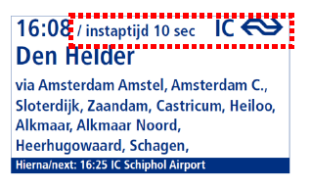
Supporting the trainmanager to depart on time (2)
When the trainmanager wants to close the doors of the train and depart, he triggers the second display (with his smartwatch) and the display will show that the train will depart in 10/9/8/7….seconds.

Slide 6
Supporting the trainmanager to depart on time
When the 10 seconds have passed, the display will no longer show the destination information but the announcement that the train will depart and the message “Niet meer instappen/No more boarding”. Possibly we will show the next train to the same destination (to be defined later).

Slide 7
Showing train length and facilites in relation to platform
Because trains are very full during peak hours, we also want to communicate to our passengers where the train will stop in relation to the platform.
As we currently do not show this information for domestic trains we need to develop how and when we want to show the train length on our displays including which information we want to show (train facilities like 1st class, wheelchair entrance etc., silent compartments etc.)
We want to learn from other railway companies and develop an image that our passengers find easy to understand and will fit in with our displays.
A very important issue is that the train driver needs to stop at the right place: humans and technology need to work closely together to make this happen.

Slide 8
Showing train length and facilities in relation to platform (2)

Slide 9
Where and when, plus our most important challenges
This first part of the POC will be held at Utrecht Central Station, and at only one platform. We aim to be ready for this in Q2 of 2019.
We need to rebuild part of our publication system (InfoPlus-PUB) to be able to separate the displays belonging to this platform from the rest of the displays and show a different image to our passengers (at this moment we can only show one image for all displays). This will also help new developments later on.
We also have to unlock new data streams (from the cloud).
Furthermore we need to ensure that we have a fall-back to the “old” image in case things go wrong or we have a disruption in our trainservice.
And we need to prioritise what information is most important in which situations (develop scenarios and decide what to do in each scenario).
Notes:
Because in the future we can separate displays we can more easily test new display images with customers/passengers on a certain station or platform. We will also develop in html-5 which is much more easy to develop in and gives us room to shorten development time.

Slide 10
Customer survey to decide whether the POC is successfull
Once we start the proof of concept, we want to evaluate whether it is successfull:
By observing passenger’s behaviour
By doing customer surveys
By measuring whether trains depart better on time or not
By evaluating how our own personnel experience this change
Notes:
All this needs to be developed from now on.

Slide 11
Showing how busy the train is (with real-time data)
Our ambition is to also show how busy the train is
In the beginning probably with historical data: how busy is the whole train usually
Later with real-time data, even showing which part of the train will be very busy and which part still has room for passengers
This to enable passengers to find a seat and to spread over the platform.
This can have an important effect on our punctuality if in this way we can speed up the process of departure
We need to develop how to show this on our displays, and to unlock relevant data
Notes:
This will also give our passengers more sense of control over their journey and, even though the train is busy, they can adjust their behaviour and have more chance to find a seat and not have to stand in the train.

Slide 12
How: Agile IT Development flexible short term development with scrumteams and ProductOwners
Flexibele way of (software) development. A means to the greater goal: efficient software development in small steps so we can take improvements quickly in production.
ProductOwner is responsible for the balance between cost and value.
Authorization lies with the ProductOwners from the business with businessgoals within financial framework.

Slide 13
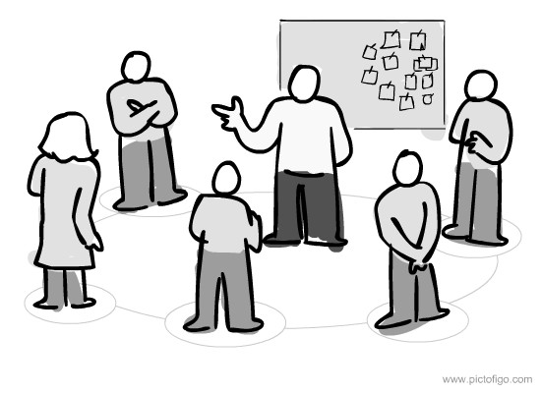
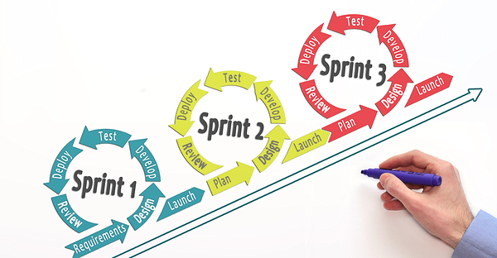
How do development teams work? Self organising team that works in sprints of two weeks to deliver value
Every ‘product’ has a ProductOwner with his/her own team with different expertise: information analist, developers and testers
The team works in so-called sprints of two weeks in which they deliver value to improve the product.
A sprint can be seen as a small defined project.

Slide 14
Our Questions to you
Do you have similar issues?
How do you show train composition in relation to the platform on your displays?
Do you have real-time data about how busy a train is?
Do you have real-time data about train composition and polarity of the train?
Your questions/suggestions to us?

